Slide 1
Communication And Culture

Slide 2
Table of contents
Objectives
Methodology
01
02
Analysis
Conclusions
03
04
You can describe the topic of the section here
You can describe the topic of the section here
You can describe the topic of the section here
You can describe the topic of the section here

Slide 3

Culture diversity
“The Beuty Of The World Lies in The Diversity Of Its People”

Slide 4

Benefits
Culture provide people with ways of thinking, seeing, hearing and interpreting the world.

Slide 5

Misunderstanding
Cultural differences increase the likelihood of misunderstanding as well. If people speak different languages, the danger of bad translation is obvious. But even if people speak the same language, they may communicate in different ways.

Slide 6

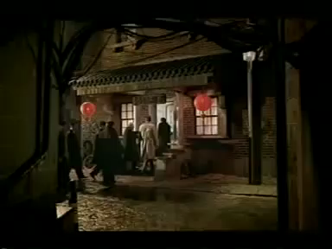
Misunderstanding

